Slide 1

Apache Druid® Ingestion and Data Modeling
Segment Organization
Press Start to begin

Slide 2
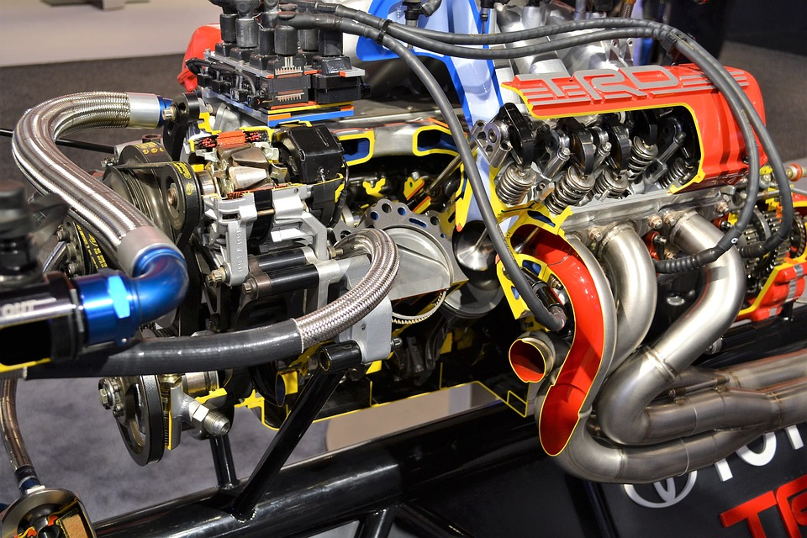

Slide 3
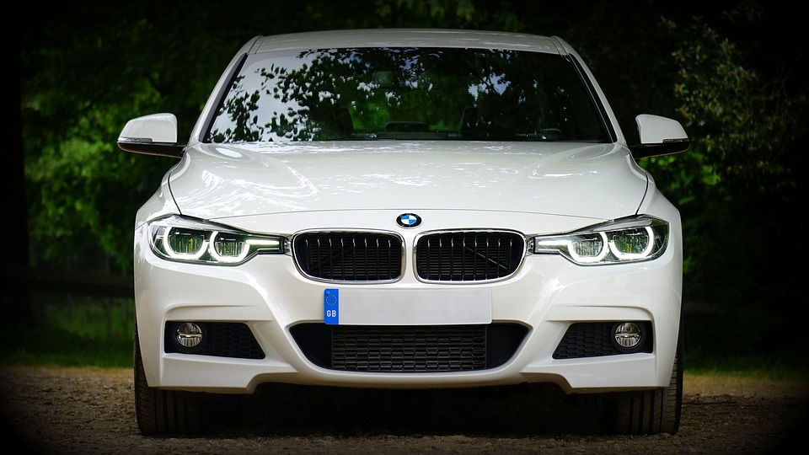

Slide 4










__time | Column A | Column B
2022-01-01T01:00 | - | -
2022-01-01T01:10 | - | -
2022-01-01T01:20 | - | -
2022-01-01T01:30 | - | -
2022-01-01T01:40 | - | -
2022-01-01T01:50 | - | -
2022-01-01T02:00 | - | -
2022-01-01T02:10 | - | -
2022-01-01T02:20 | - | -
"granularitySpec": {
"segmentGranularity": "hour",
"queryGranularity": "minute”
}
Time Chunk
Time Chunk
Time

Slide 5
__time | Column A | Column B
2022-01-01T01:00 | - | -
2022-01-01T01:10 | - | -
2022-01-01T01:20 | - | -
2022-01-01T01:30 | - | -
2022-01-01T01:40 | - | -
2022-01-01T01:50 | - | -
2022-01-01T02:00 | - | -
2022-01-01T02:10 | - | -
2022-01-01T02:20 | - | -
Memory

Slide 6
__time
2022-01-01T01:00
2022-01-01T01:10
2022-01-01T01:20
2022-01-01T01:30
2022-01-01T01:40
2022-01-01T01:50
2022-01-01T02:00
2022-01-01T02:10
2022-01-01T02:20
Column A
-
-
-
-
-
-
-
-
-
Column B
-
-
-
-
-
-
-
-
-

Slide 7
Segment
Segment
Segment
Segment
Segment
Segment
Segment
Segment
Historical
Process

Slide 8
An ideal segment:
Contains about 5 million rows
About 300-700 MB in size

Slide 9
This is an upper bound for the segment size
{
"type": "index_parallel",
"spec": {
"dataSchema": {
…
"granularitySpec": {
"segmentGranularity": "hour",
"queryGranularity": "minute"
}
},
…
"tuningConfig": {
"type": "index_parallel",
"maxRowsInMemory": 25000,
"maxBytesInMemory": 250000,
"partitionSpec": {
"type": "dynamic",
"maxRowsPerSegment": 5000000
}
}
}
}
"tuningConfig": {
"type": "index_parallel",
"maxRowsInMemory": 25000,
"maxBytesInMemory": 250000,
"partitionSpec": {
"type": "dynamic",
"maxRowsPerSegment": 5000000
}
}

Slide 10
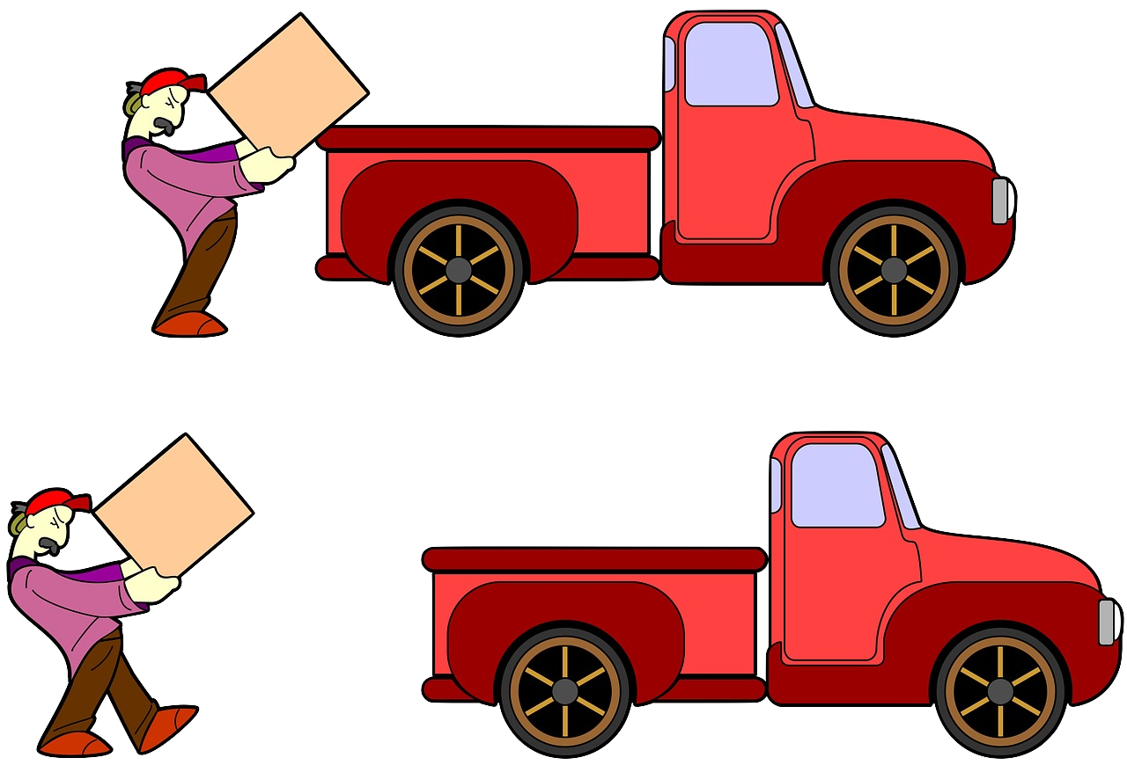

Slide 11

What is the right segment size?

Slide 12


Slide 13
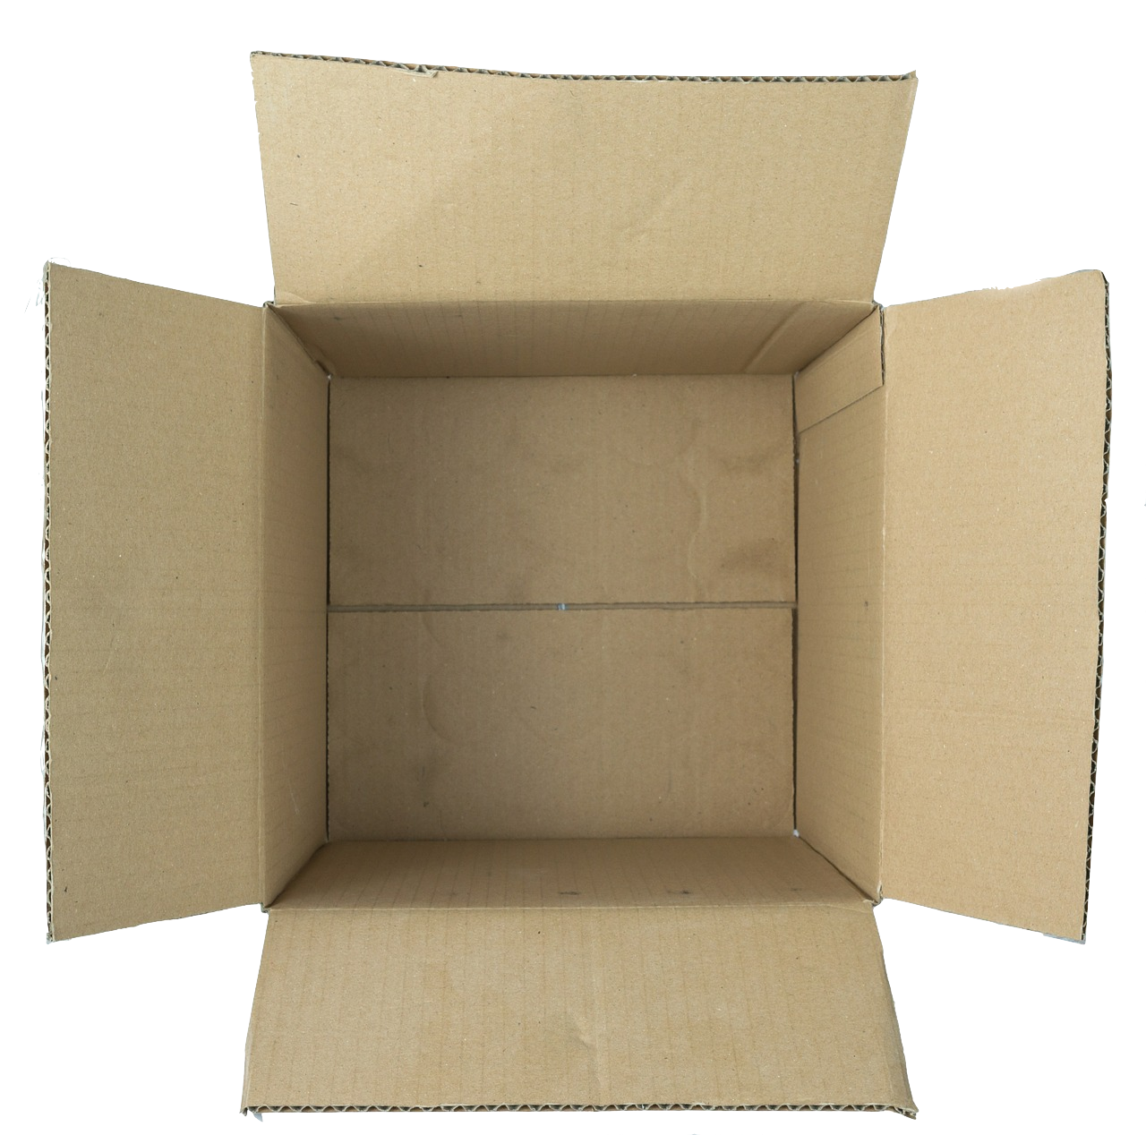

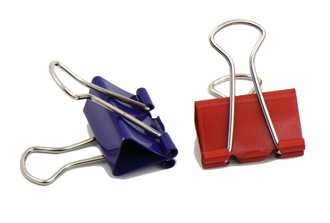
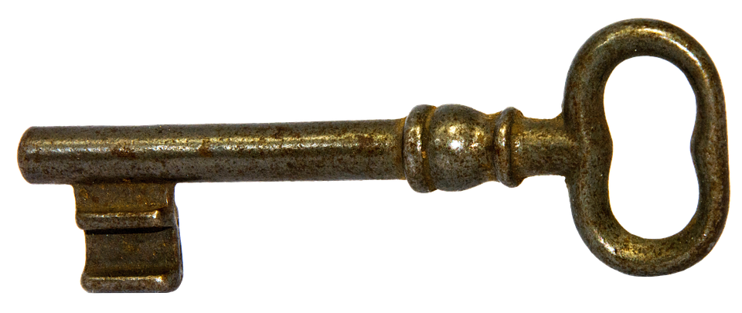
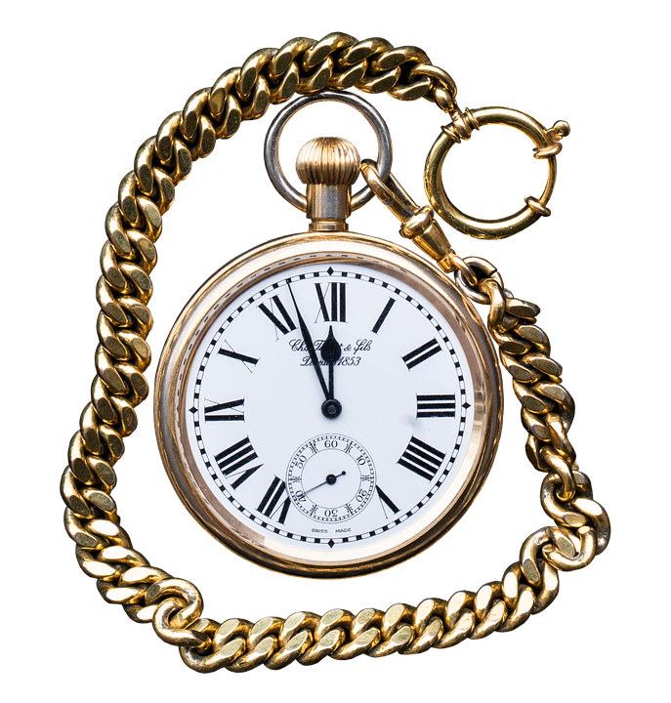
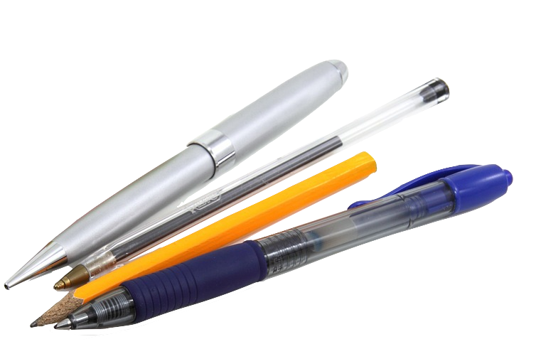
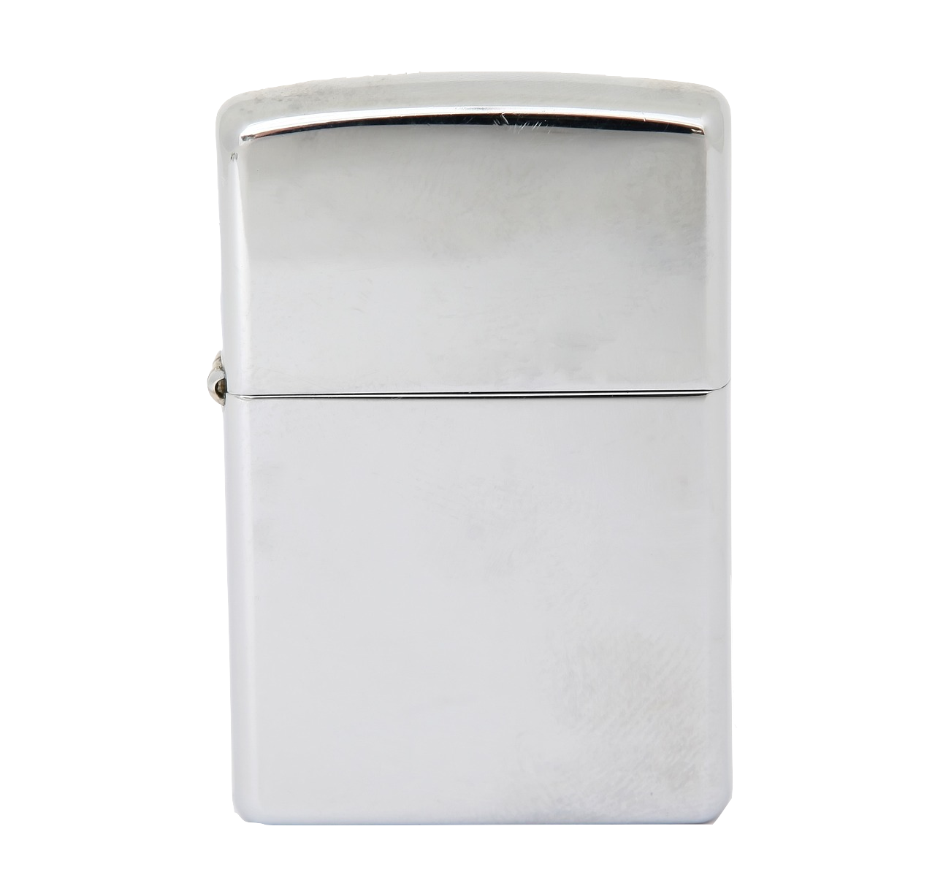

Slide 14

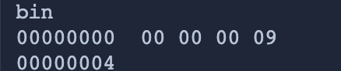
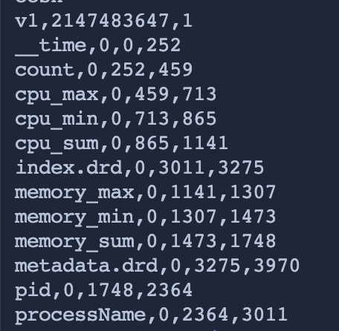
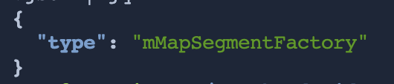
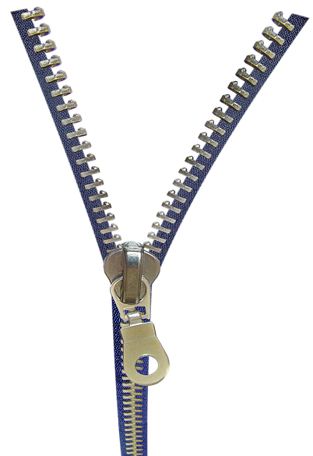
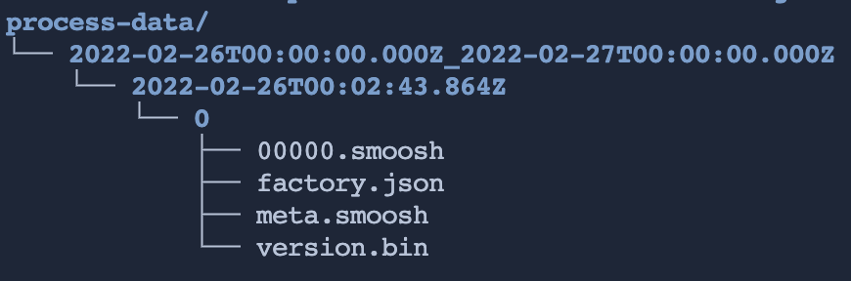
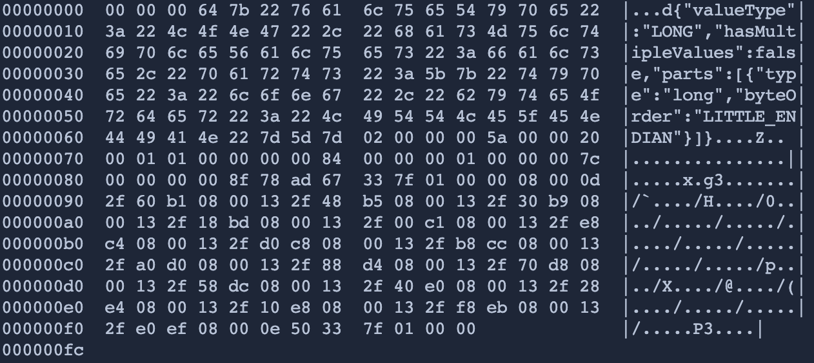
Segment
Cache
factory.json
00000.smoosh
version.bin
meta.smoosh
factory.json
Historical
zip
Segment
Deep Storage

Slide 15
.
.
.

Slide 16
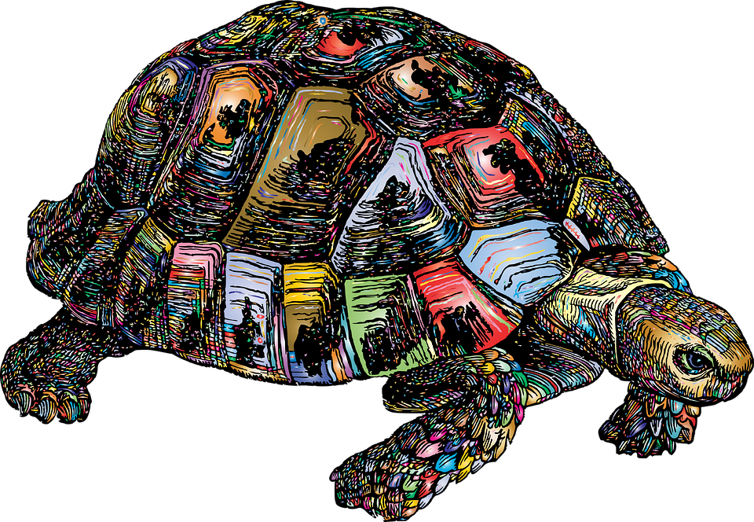
__time | Column A | Column B | Column C | Column D | Column E | … | Column Z
2022-01-01T01:00 | - | - | - | - | - |  | -
2022-01-01T01:10 | - | - | - | - | - |  | -
2022-01-01T01:20 | - | - | - | - | - |  | -

Slide 17


Slide 18
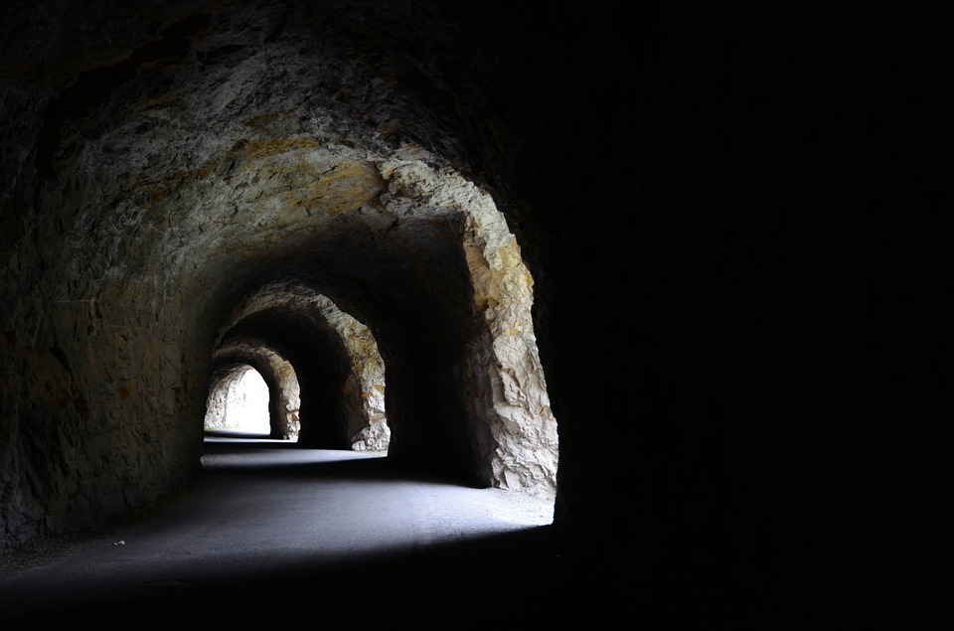

Slide 20


